Slide 1
Summary of Research
“Mapping Shrimp Feed Supply Chain in Songkhla Province to Facilitate Feed Dialogue”
Submitted to Oxfam Thailand in March 2014
30 July 2014
Lead Researcher: Sarinee Achavanuntakul, Sal Forest Co. Ltd.
Research Team: James True, Srisakul Piromwarakorn
Prince of Songkhla University
Pattraporn Yamla-Or, Koranis Tanangsnakool, Sasiwimon Klongakkara
Sal Forest Ltd. : www.salforest.com

Slide 2

Who is Sal Forest?
“Sustainable Business Accelerator”
Sal Forest is Thailand’s first sustainable business accelerator. We aim to jumpstart and sustain a public discourse on sustainable business via events, print and online media, as well as conducting research on important sustainability issues in Thailand and social impact assessment.
2
Notes:
2

Slide 3
Sal Forest’s products and services
Tours
Knowledge Dissemination
Knowledge Development
Research
Training
Creating Network and Public Awareness
Impact Assessment
Books & Web
Seminar
3

Slide 4
Research Objectives
To establish and quantify, as much as possible, the impact of shrimp feed industry on the livelihood of fishing communities in Songkhla
To map the supply chain of shrimp feed industry in Songkhla, including market shares and key activities of major stakeholders in supply chain, and
To review environmentally sustainable business practices carried out in the similar context and formulate practical recommendations for further discussion with business stakeholders

Slide 5
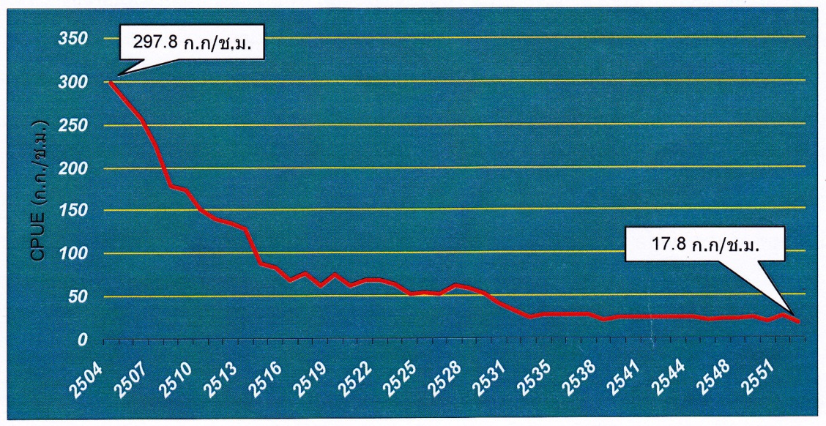
Overview of fishing industry: Thailand
Catch Per Unit Effort from 1961 – 2010 (kilograms per hour)
Source: Boonwanich & Boonpakdee, 2009

Slide 6
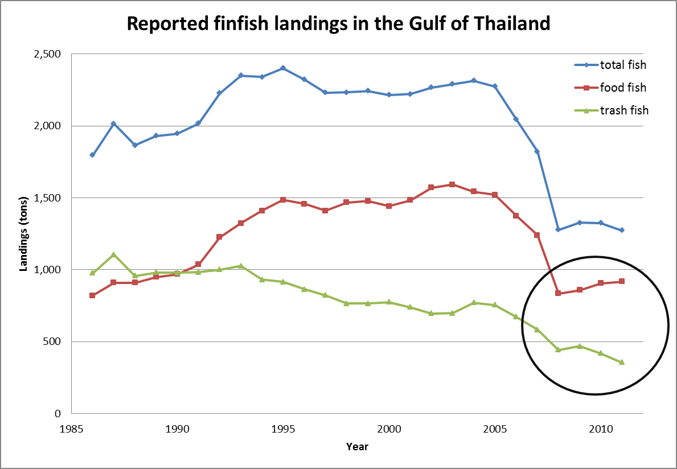
Source: Department of Fisheries, 1986-2011

Slide 7
Songkhla fishmeal industry: impact and size
Fishmeal industry creates impacts on ecosystem and local artisanal fishing community
  It is the main market of “by-catch,” including under-sized and juvenile fish; therefore, supports the continued existence of destructive fishing conducts
In 2011, Songkhla was Thailand’s second largest fishmeal producer, the largest of the South, and accounted for 12.03% of country’s total fishmeal production.
62% of catch landed in Songkhla is by-catch, approximately 6.5 tons/vessel, totaling est. 25,000 tons per year

Slide 8
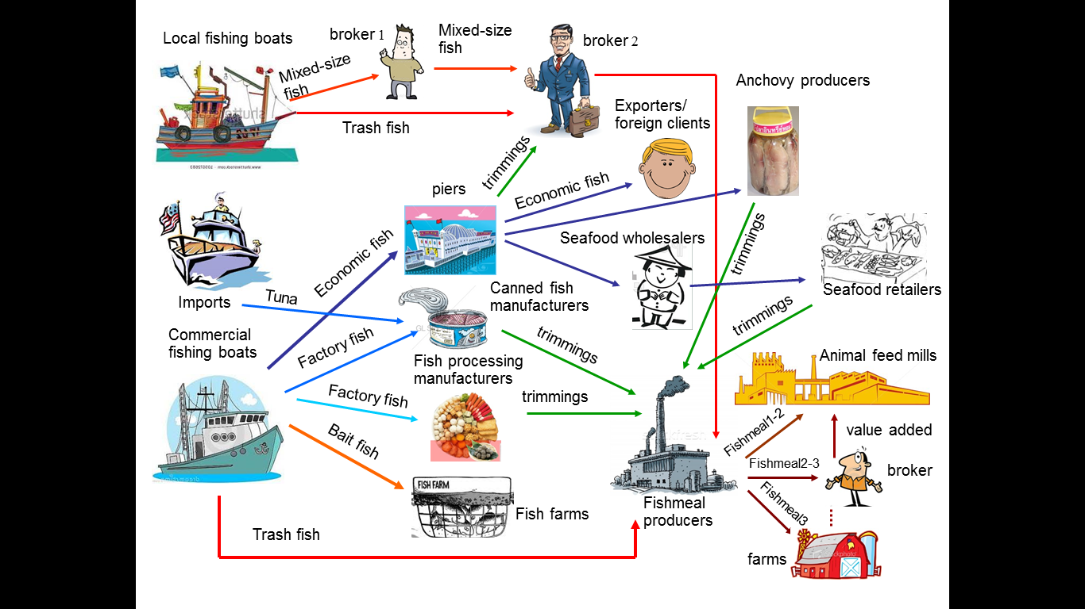
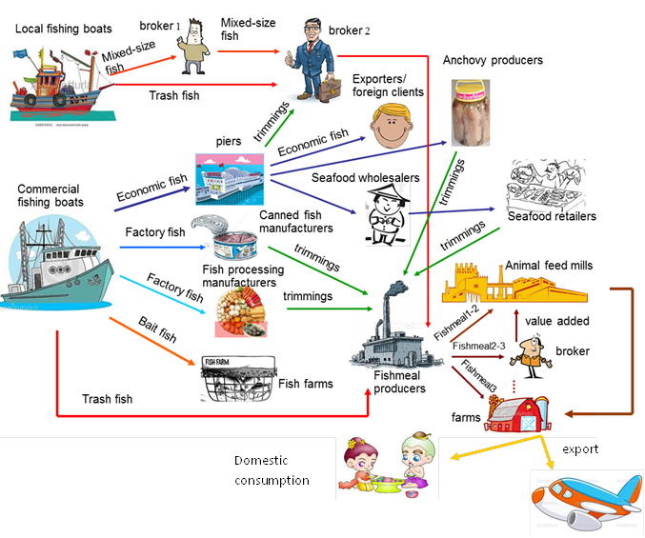
Map of fishmeal supply chain in Songkhla
Source: Interviews and analysis by research team

Slide 9
Fishmeal supply chain & by-catch usage
In 2013, 8 of 9 fishmeal producers in Songkhla produced 28,509 tons of fishmeal in total
  100,215 tons of raw materials >> trimmings 79,965 tons (80%), whole fish 20,250 tons (20%), of which 5,760 tons were by-catch landed in Songkhla
  66% (18,814 tons) of fishmeal were sold to large feed mills, namely CPF 45%, Betagro 17%, Thaiunion Feedmill 11%
1,527 tons of fishmeal produced from by-catch were sold to
  CPF 575 tons or 37.6% (300 tons of which were traceable)
  Farms 300 tons or 19.7% (all were traceable)
  Brokers 652 tons or 42.7% (all were traceable)

Slide 10
Shortcomings of Thai fisheries law & draft new law
Shortcomings of Thai Fisheries Act, 1947
  Fishing area is not clearly identified
  Inappropriate fishing gears and practices (e.g. small mesh size) are not illegal
  Violators must be “caught in the act”
Draft of the new fisheries act
  To effectively and efficiently respond to present fishing activities
  Clearer demarcation of fishing grounds and defined authority to mandate type, number, size, and components of fishing gears should help make damaging practices illegal

Slide 11
Many Thai companies subscribe to int’l standards
6 most popular international standards and certified Thai companies (as of February, 2014)
Thai companies that have plants certified
No Thai company certified under these standards
Global G.A.P.
As of Feb 2014, only CPF is certified. (Thaiunion and Krungthai certifications have expired in 2013.)
MSC
ASC
BAP
29 processing plants
34 farms
8 hatcheries
6 feed mills
IFFO RS
CPF and T.C. Union Agrotech are member
Friend of the Sea
Thai Spring Fish

Slide 12
Fishmeal certificate scheme
To date, CPF is the only feed mill that submitted documents to Department of Fisheries for verification
There were 1,752 fishmeal certificates from 26 fishmeal producers during a period from 10 June – 31 December 2013
Paper trail only – no way to verify actual fishing conducts and fishing location

Slide 13
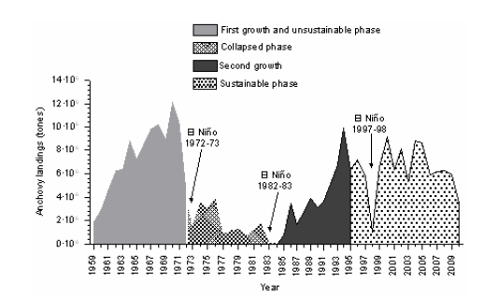
Four decades until “sustainable fishing” era in Peru
Source: Freon et. al, 2008

Slide 14
Lessons from Peru
The need for standards that encompass all players as well as a combination of laws and industry involvement and self-regulation
The need to utilize science-based data and technology to ensure sustainability and effective enforcement
The clearer the business case for sustainability, the more incentives players have to comply with sustainability laws/standards/schemes

Slide 15
Thank you!
Summary report can be downloaded from www.salforest.com
page “Knowledge”
http://www.salforest.com/knowledge/trashfish-research-aug

