Slide 1
Sustainable fisheries development
Dr. Smith Thummachua
Department of Fisheries

Slide 2
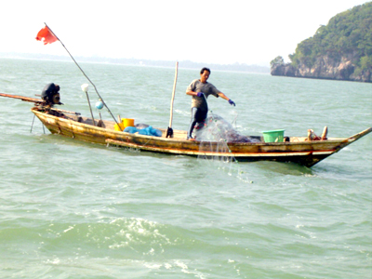

Slide 3
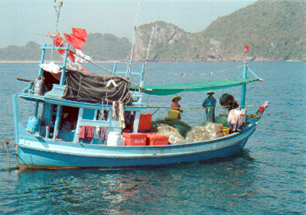
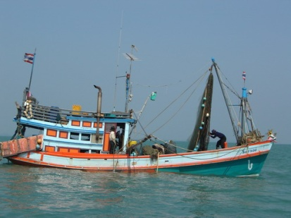
Fishing Vessel

Slide 4
Certificate of Registration
Ship’s License
Registry
Fishing Vessel
DOF
Right to Fish Using a Certain Gear

Slide 5
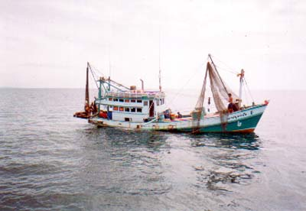
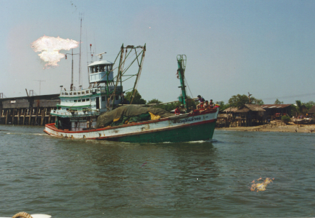
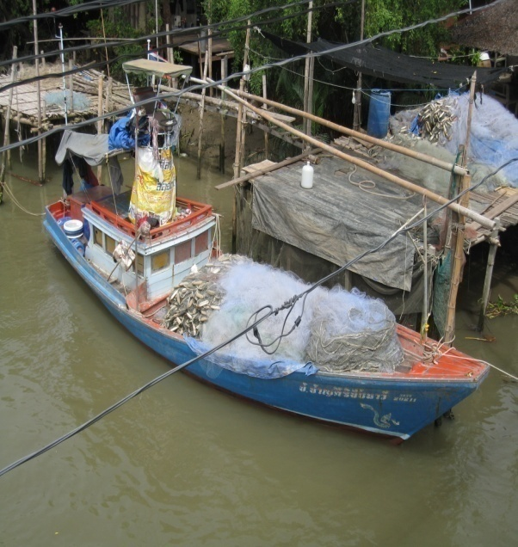
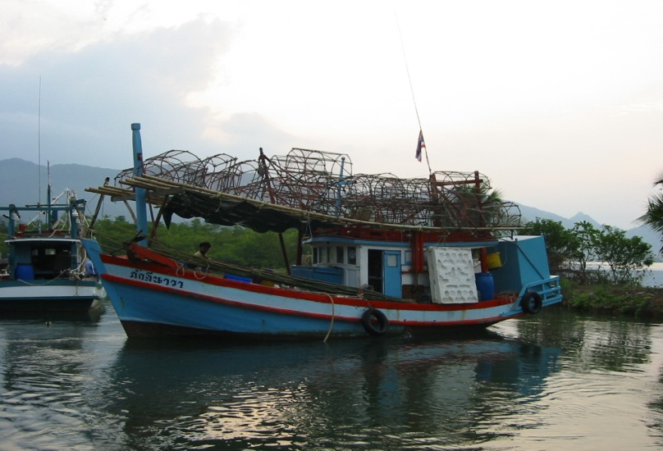
Main Fishing Gear
Trawl
Purse Seine
Gill Net
Falling Net
Lift Net
Push Net
Trap
Dredge
Long line

Slide 6
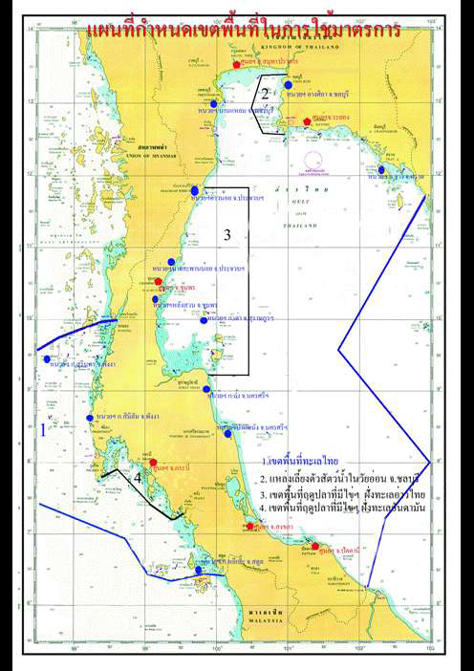
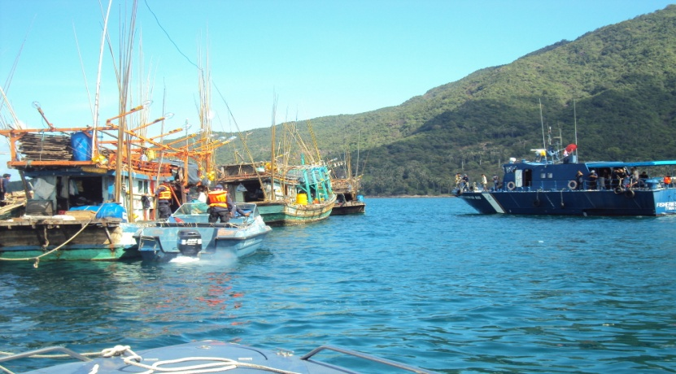
Law Enforcement

Slide 7
Fisheries Management
(Input Control)
Licensing of vessels in Thai and foreign waters
Seasonal closed areas
15 Feb – 15 May & 1 Jun – 31 Jul in GOT
1 Apr – 30 Jun in Andaman Sea
3 km. or 3 mile conservation zone
Fishing gear restrictions
Participation of local community/fishery association in management

Slide 8
Authorization of vessels to fish in IO
Monitoring of at-sea transshipment
Monitor fishing operation of Thai fishing vessels in IO through VMS and logbook
Implement other IOTC resolutions

Slide 9


Combat IUU Fishing
Export to EU
Carrier
Processing Plant
Fishing Vessel
MCPD
Fish Trader
(MCPD)
Logbook
Catch Cert.
MCTD & Logbook
DOF

Slide 10
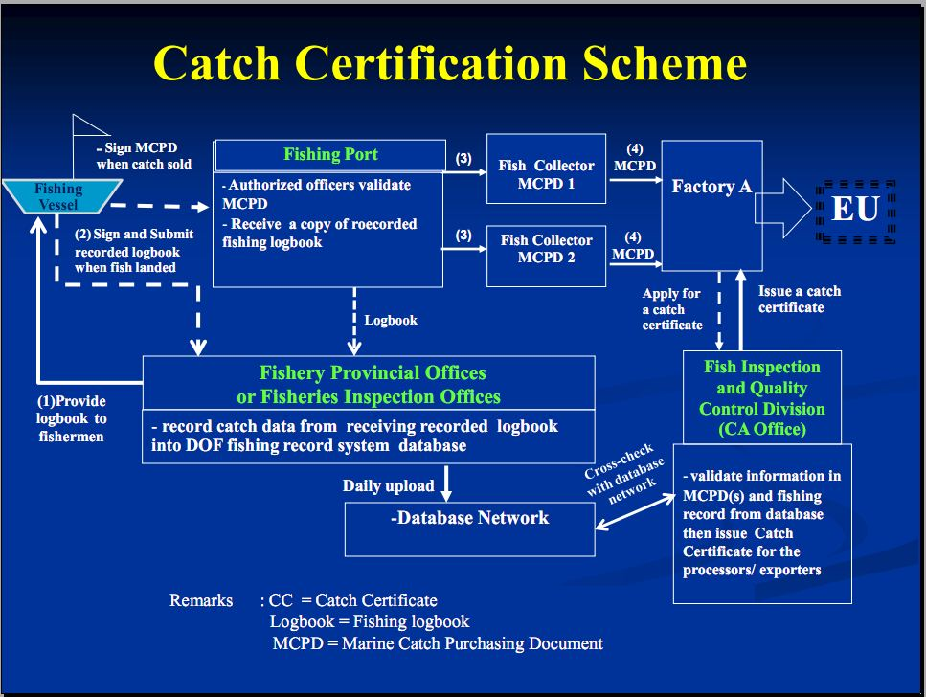
ฃ

Slide 11
Fishmeal Traceability Scheme
Based on scheme to combat IUU fishing
Market incentive – Driving force
DOF validating agency

Slide 12
Review/
Investigation
Traceability
Fisheries Improvement Plan : FIP
Fisheries/IUU
Law

Slide 13
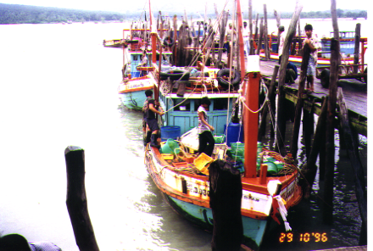
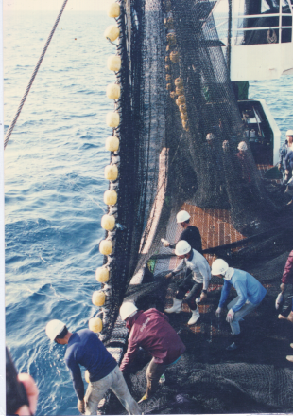
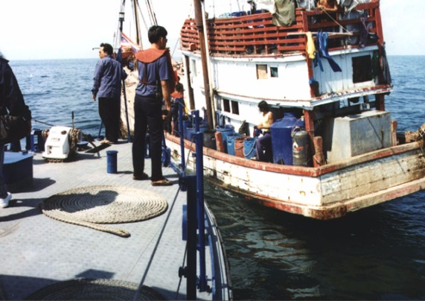
THANK YOU

